Slide 1
Unit 1 Bargaining Climate: Bill 124
It’s bad, but we can still fight for the best
Collective Agreement!
Illustration by William Harrison
Notes:
Hello everyone. We’re pleased to begin a conversation about climate facing our union as we begin Unit 1 bargaining this academic year. Although huge issues such as the COVID-19 pandemic and ongoing attacks from an anti-labour government can be dispiriting, we hope that by laying out the facts about Bill 124 and other barriers to a fair deal for our membership, we can clarify the difficult bargaining climate and inspire members to take action. As a result, this presentation will focus on defining Bill 124, explaining its effects on our work lives, and exploring ways of dealing with it.

Slide 2
What is Bill 124?
Austerity legislation introduced by Peter Bethlenfalvy, President of the Treasury Board
It was passed and received Royal Assent in November 2019
Long title: An Act to implement moderation measures in respect of compensation in Ontario’s public sector
Short title: Protecting a sustainable public sector for future generations act
Notes:
Bill 124 is austerity legislation introduced by Peter Bethlenfalvy, President of the Ontario Treasury Board. The legislation is deceptively titled, with language such as “sustainability” and “moderation” meant to conceal its real purpose as a financially unnecessary attack on public-sector workers. With the long title “An Act to implement moderation measures in respect of compensation in Ontario’s public sector” and the short title “Protecting a sustainable public sector for future generations act”, the government frames this legislation as a necessary measure to deal with the provincial deficit and to protect future generations. It was passed and received Royal Assent in November 2019, but public sector unions have struggled against it every step of the way.

Slide 3
Who does it apply to?
Unionised and non-unionised Ontario public-sector employees
Government of Ontario
Provincial crown agencies (e.g. Ontario Power Generation)
Broader public sector
hospitals, school boards, universities, agencies under the Long-Term Care Homes Act and non-profit organisations that receive at least $1 million in government funding
Notes:
This legislation impacts both unionised and non-unionised employees in the public sector, workers directly employed by the government of Ontario and by crown agencies such as Ontario Power Generation. However, a significant number of workers in the broader public sector are also impacted, including those who work at: hospitals, school boards, universities, agencies under the Long-Term Care Homes Act, and even non-profit organisations that receive at least $1 million in government funding.

Slide 4
What does Bill 124 do?
Financially
Imposes compensation caps on public-sector workers
Politically
Strips your bargaining and human rights
Pits workers against one another
Reinforces discrimination and oppression
Notes:
Bill 124 has sweeping effects--both financial and political--on the lives of public-sector workers. In financial terms, the legislation imposes compensation limits. The political effects are yet more troubling, though, in that our right to bargain collectively is unjustly violated, and public workers continue to be scapegoated by the legislation as having taken too much from the government. Ultimately, Ontario doesn’t have a spending problem, but instead a revenue problem--if the Ford government truly cared about the deficit, it would increase taxes on corporations and the wealthy, such that Ontario would no longer have the lowest per capita public revenue in Canada, and it would NOT trample on the bargaining rights of public-sector workers. Collective bargaining is a human right, but the Progressive Conservatives aim to pit non-unionised and private sector workers against us by implying it’s a frivolous privilege public-sector employees have abused.

Slide 5
Bill 124’s Financial Impact
Imposes austerity periods of three years
During these austerity periods, compensation can only be increased by up to 1% a year
Compensation includes wages, benefits (e.g. healthcare insurance and funds) and one-time payments (e.g. signing bonuses)
Minken Employment Lawyers: “Under the statute, salary rate increases are limited to one (1) percent per twelve (12) month period for each position or class of positions.”
Notes:
Having laid out the basics of what Bill 124 does in broad strokes, we can now address the specific financial limits that the law imposes. First, it bears mentioning that these limits are technically temporary, and apply to contracts and collective agreements for three years once signed. These are referred to as “moderation periods”, in line with the government’s “financial sustainability” language, but ultimately they are really draconian austerity periods, that can likely set a precedent for more compensation cuts in the future. The deceptive thing here is that a 1% limit is applied to annual compensation increases, such that--at first glance--this does not seem to be a cut in the traditional sense. However, given that inflation rates fluctuate between 1.5 and 2%, depending on time of year and the method of analysis, a 1% raise effectively means a cut in terms of purchasing power. This cut will be especially hard for all members of our union to shoulder, as most of us (especially those supporting families, or paying off student debt) are already having trouble paying for basic necessities. What’s worse, not only wages, but also any form of compensation are effectively cut in this way: our equity and financial assistance funds will barely be able to grow through increased contributions from the university, and even our healthcare top-up plan will be thrown into financial stasis.
It is also worth noting that the 1% cap does not apply exclusively to individuals, so that no one employee can receive more than a 1% compensation increase; it also applies to entire job categories (e.g. Invigilators, TAs, Chief Presiding Officers, etc.). In previous years you as members have decided to improve the material conditions of our most precarious workers by negotiating a higher increase for them than you did for the most financially secure members*. Under this legislation, that choice has been taken away from you.

Slide 6
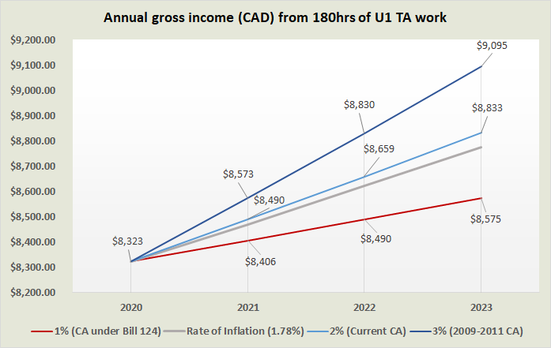
What a 1% cap looks like (for TAs)
See this slide for references
Notes:
To put the 1% wage cap into perspective, we drafted a graph to show how the capped wages (in red) compare against our current collective agreement’s wage increase rate (just above inflation), and the highest wage increase rate we had in recent years (in dark blue). For a TA working the standard 180 hours, this will mean a loss of $511 over three years relative to our current rate increase, and $1027 relative to our highest rate increase. When considered in conjunction with the fact that many Unit 1 members already live below the poverty line, such cuts are unconscionable.

Slide 7
Can we afford a 1% cap?
In 2020, the average cost of living in Toronto was $42,494.88 per year (most expensive city in Canada after Vancouver)
Statistics Canada: from 2000 to 2010, the average doctoral student debt on graduation increased from $20,200 to $28,700 (42% increase)
Recent crowd-sourced reports show debt has increased
Things are getting even worse with the Post-Secondary Education (PSE) cuts and OSAP changes that took effect in July 2019
Notes:
Having mentioned the poverty line, it also bears mentioning what expenses Unit 1 members face with their already limited incomes. In 2020, the Toronto average cost of living required an income of at least $42,494.88 per year, making Toronto the 2nd most expensive city to inhabit in Canada, after Vancouver. What’s more, statistics Canada shows that the average doctoral student debt on graduation increased from $20,200 in 2000 to $28,700 in 2010. More recent crowd-sourced reports on PhD student debt show it increasing further still. Our funding packages are already well below the average cost of living, so how can graduate students afford to live securely while also paying off ballooning debts? The problem is further compounded by the changes to OSAP that took effect in July 2019, as well as other cuts to Post-Secondary education.

Slide 8
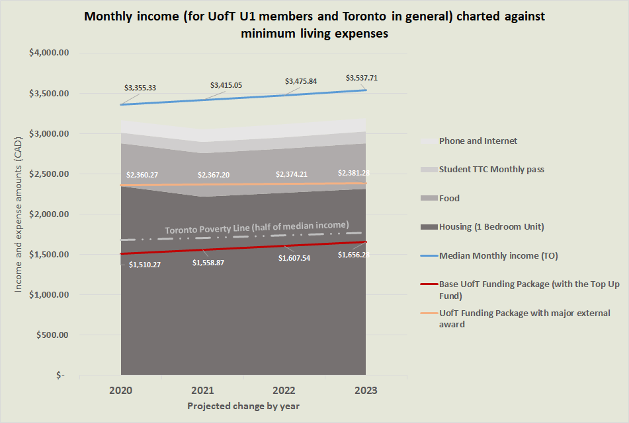
Cost of Living: Rent Is Too Damn High
See this slide for references
Notes:
We’ve illustrated here how, notwithstanding other burdens such as debt or supporting dependents, the costs of living in Toronto are astronomical, with even the city’s median income (in blue) barely breaking even. Graduate student funding packages were already well below this median income, with base funding falling below the poverty line. Even well-funded Unit 1 members with external awards cannot afford the projected minimum expenses of someone living securely in Toronto. A 1% limit on annual compensation increases will further strain Unit 1 members’ finances, especially those beyond the funded cohort or supporting families.

Slide 9
Political impact: Bill 124 strips you of
your rights
Canadian Charter of Rights & Freedoms enshrines your right to free and fair collective bargaining process under the “Freedom of Association” provision
Freedom of association guarantees the right of employees to meaningfully associate in the pursuit of collective workplace goals, which includes a right to collective bargaining. That right is one that guarantees a process but does not guarantee an outcome or access to a particular model of labour relations [...]. The right to a process of collective bargaining means that employees have the right to unite, to present demands to the employer collectively and to engage in discussions in an attempt to achieve workplace-related goals. […] It also places constraints on the exercise of legislative powers in respect of the right to collective bargaining [...].
Notes:
And as we saw before, the impacts of Bill 124 are not exclusively financial: they are also political. In 2007, the Supreme Court of Canada enshrined the right to free and fair collective bargaining under the Freedom of Association provision of the Canadian Charter of Rights and Freedoms. By prohibiting us from negotiating compensation increases beyond 1%, this legislation is stripping you of your right to present demands to the employer collectively. In fact, similar austerity legislation was recently struck down in Manitoba on the grounds that it interfered with this charter-protected right. Collective bargaining rights are human rights, and any attempt to water them down is a trampling of our freedoms.

Slide 10
Political impact: Bill 124 strips your rights
A coalition of Ontario unions, including CUPE, has presented a joint legal challenge, under counsel of Goldblatt Partners LLP
12 June 2020: similar austerity legislation by the Pallister Conservative government in Manitoba (Bill 28: Public Services Sustainability Act) was struck down as unconstitutional
Notes:
Constitutional challenges take time. Bill 124 is almost certain to remain in place for the duration of this round of bargaining.
https://www.hrreporter.com/focus-areas/legislation/unions-want-ontarios-bill-124-repealed-after-manitoba-decision/330519: On June 12, Manitoba Court of Queen’s Bench Justice McKelvey found that the provincial government’s Public Services Sustainability Act (Bill 28) interferes with the right to collective bargaining and violates the freedom of association guarantee in the Canadian Charter of Rights and Freedoms.
Canadian Charter of Rights and Freedoms: Charterpedia: https://www.justice.gc.ca/eng/csj-sjc/rfc-dlc/ccrf-ccdl/check/art2d.html

Slide 11
Political impact: Pits workers against one another
Intentionally creates divisions among workers by signaling to private-sector workers that public-sector wages and benefits are a problem
Pits public-sector workers against one another
The legislation states that “the Minister may, by regulation, exempt a collective agreement from the application of this Act”
Ontario Nurses Association (ONA) is fighting for such an exemption, rather than fighting together with other sectors to repeal austerity legislation
Notes:
Another pernicious consequence of this legislation is the pitting of workers against one another. This divide-and-conquer strategy is two-fold: first, it intentionally creates divisions between private- and public-sector workers by suggesting that the latter are entitled and overcompensated, and that their fair wages and benefits are to blame for the deficit when the opposite is true: gains made by public-sector workers benefit all of society by raising the bar on working conditions. Sadly, this legislation also pits workers within the public-sector against one another. The legislation gives the Minister the discretion to exempt a collective agreement from the act, a measure that would undoubtedly be used only when it is politically expedient to do so. And, in fact, we already see certain sectors campaigning for an individual exemption, without regard for the plight of workers in other sectors.

Slide 12
Political impact: Reinforces discrimination & oppression
Reinforces gendered wage discrimination
At the municipal level, gives municipal councilors greenlight to increase already-bloated police budgets
Notes:
Disturbingly, the legislation also reinforces discrimination and oppression, not just in the workplace, but in our communities. Largely male-dominated positions such as police and fire services are exempted from the legislation, while female-dominated professions such as teachers and healthcare workers are targeted. Most troubling: Bill 124 gives municipal councillors the green light to increase already-bloated police wages and budgets in a period when there are international calls to defund racist policing institutions. There is no doubt that this will result in the continued and disproportionate targeting of residents who are poor, who have mental-health issues or who are members of racialised communities.

Slide 13
How is Bill 124 enforced?
Introduces anti-avoidance measures
Employers cannot pay out compensation before or after the austerity periods to make up for cuts
Grants significant compliance powers to the Ontario Treasury Board
Minister can “make an order declaring that a collective agreement or an arbitration award is inconsistent with this Act,” forcing us to negotiate concessions
Notes:
Unfortunately, Bill 124 uses drastic enforcement measures to prevent you from working around this unfair legislation. This enforcement takes two forms: anti-avoidance measures and compliance powers. In terms of the former, for example, the employer could not give a one-time payment during the remainder of our current collective agreement to anticipate the impact of the cuts in the next collective agreement. Nor could we take steps like negotiating a four-year collective agreement that includes significant wage increases in the fourth year to make up for the cuts in the first three years of the collective agreement.

Slide 14
Wage caps won’t help the provincial budget
Provincial funds are not based on your compensation, but on a per-student basis
On average, provincial funds represent only about a third (35%) of university revenue
Wage increases in the university sector will have a negligible impact on the provincial deficit
Ontario has a revenue problem, not a spending problem
Notes:
Universities get funding from multiple sources, of which provincial funding is a relatively small percentage. Money saved by the province here is not even a drop in the bucket of the deficit.

Slide 15
What about non-monetary issues?
Bill 124 does not limit our ability to bargain non-compensation issues such as hiring, job security, harassment & discrimination, workload, accommodations, mental health resources, health and safety, etc.

Slide 16
How can we deal with Bill 124?
Discussion
Notes:
As members, your feedback guides the bargaining process. The information presented to you here is meant to empower you to engage in the consultation process led by your bargaining team with the right knowledge.

Slide 17
References for wages figure (TAs)
Rate of increase | 2020 | 2021 | 2022 | 2023
1% (Bill 124 limit) | $ 8,323.00 | $ 8,406.00 | $ 8,490.00 | $ 8,575.00
1.78% (inflation)¹ | $ 8,323.00 | $ 8,471.00 | $ 8,622.00 | $ 8,776.00
2% (Current Rate)² | $ 8,323.00 | $ 8,490.00 | $ 8,659.00 | $ 8,833.00
3% (2009-2011)³ | $ 8,323.00 | $ 8,573.00 | $ 8,830.00 | $ 9,095.00
Calculated as a mean average of monthly core inflation rates in 2020 (trimmed mean approach). Statistics Canada. Table 18-10-0256-01 Consumer Price Index (CPI) statistics, measures of core inflation and other related statistics - Bank of Canada definitions DOI: https://doi.org/10.25318/1810025601-eng
CUPE 3902. Collective Agreement between the Governing Council of the University of Toronto and The Canadian Union of Public Employees Local 3902, Unit 1. January 1 2018 - December 31, 2020. Article 26: Salaries.
CUPE 3902. Collective Agreement between the Governing Council of the University of Toronto and The Canadian Union of Public Employees Local 3902, Unit 1. May 1 2008 - April 30, 2011. Article 26: Salaries.

Slide 18
References for wages figure (CIs)
Rate of increase | 2020 | 2021 | 2022 | 2023
1% (Bill 124 limit) | $ 16,438.32 | $ 16,602.70 | $ 16,768.73 | $ 16,936.42
1.78% (inflation)¹ | $ 16,438.32 | $ 16,730.92 | $ 17,028.73 | $ 17,331.84
2% (Current Rate)² | $ 16,438.32 | $ 16,767.09 | $ 17,102.43 | $ 17,444.48
3% (2009-2011)³ | $ 16,438.32 | $ 16,931.47 | $ 17,439.41 | $ 17,962.60
Calculated as a mean average of monthly core inflation rates in 2020 (trimmed mean approach). Statistics Canada. Table 18-10-0256-01 Consumer Price Index (CPI) statistics, measures of core inflation and other related statistics - Bank of Canada definitions DOI: https://doi.org/10.25318/1810025601-eng
CUPE 3902. Collective Agreement between the Governing Council of the University of Toronto and The Canadian Union of Public Employees Local 3902, Unit 1. January 1 2018 - December 31, 2020. Article 26: Salaries.
CUPE 3902. Collective Agreement between the Governing Council of the University of Toronto and The Canadian Union of Public Employees Local 3902, Unit 1. May 1 2008 - April 30, 2011. Article 26: Salaries.

Slide 19
References for costs of living figure
Rate of change (%) | Average Expense per Individual: | 2020 | 2021 | 2022 | 2023
-5.7¹ & +2.2² | Housing (1 Bedroom Unit) | $ 2,349.00 | $ 2,215.11 | $ 2,263.84 | $ 2,313.64
+1.78³ | Food | $ 533.95 | $ 543.45 | $ 553.13 | $ 562.97
+4.66⁴ | Student TTC Monthly pass | $ 128.15 | $ 134.12 | $ 140.37 | $ 146.91
+1.78³ | Phone and Internet | $ 155.96 | $ 158.74 | $ 161.56 | $ 164.44
 | Average monthly incomes
+1.78³ | Median Monthly income (TO) | $ 3,355.33⁸ | $ 3,415.05 | $ 3,475.84 | $ 3,537.71
+1 + TUF⁵ | Base UofT Funding Package (with the Top Up Fund) | $ 1,510.27⁹ | $ 1,558.87 | $ 1,607.54 | $ 1,656.28
+1⁶ | UofT Funding Package with major external award | $ 2,360.27 | $ 2,367.20 | $ 2,374.21 | $ 2,381.28
+1.78³ | Toronto Poverty Line (half of median income)⁷ | $ 1,677.67 | $ 1,709.21 | $ 1,741.34 | $ 1,774.08
Footnotes listed on next slide

Slide 20
References for costs of living figure (continued)
Lisa Xing. Toronto residential rents dropping because of COVID-19, figures suggest. CBC News: June 18, 2020.
Emma Sandri. Ontario sets 2020 rent increase guideline at 2.2 percent. The Toronto Star: June 19, 2019.
Rate of inflation according to Statistics Canada. Calculated as a mean average of monthly core inflation rates in 2020 (trimmed mean approach). Table 18-10-0256-01 Consumer Price Index (CPI) statistics, measures of core inflation and other related statistics - Bank of Canada definitions DOI: https://doi.org/10.25318/1810025601-eng
CBC News. TTC fares are now 10¢ more expensive.CBC News: March 1, 2020.
CUPE 3902. Top-Up Fund (T.U.F.) cupe3902.org. Accessed July 13, 2020.
Calculated using the $20,000 SSHRC Doctoral Fellowship and assuming a 1% annual increase to 180hrs of Unit 1 work.
OECD. Poverty rate. OECD Data: accessed July 13. doi: 10.1787/0fe1315d-en.
Formula: product of the proportion of net vs. gross annual income and monthly median income; written (yearly net income (https://simpletax.ca/calculator) / yearly gross income [25*40*4.3*12]) * ([Median hourly wage: December '19, TEBª Jan 10, '20] * full-time workweek * average amount of weeks in a month)
City of Toronto’s Economic Data centre. Toronto Economic Bulletin: Snapshot. January 10, 2020.
Base package calculated assuming a $500 annual increase to the TUF and a 1% annual increase to 180hrs of Unit 1 work.

Slide 21
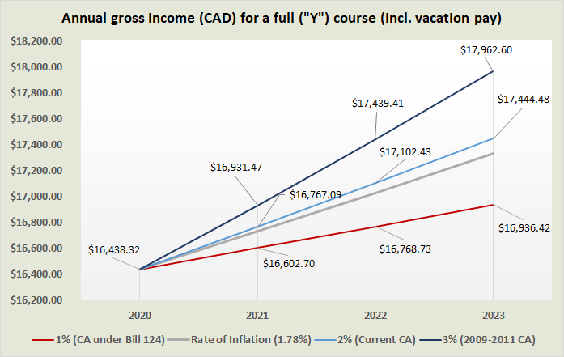
What a 1% cap looks like (for CIs)
See this slide for references
Notes:
To put this into perspective, we drafted a graph of how the cut wages (in red) compare against our current collective agreement’s wage increase rate (just above inflation), and the highest wage increase rate we had in recent years (in dark blue). For a TA working the standard 180 hours, this will mean a loss of $1006 over three years relative to our current rate increase, and $2025.63 relative to our highest rate increase. When considered in conjunction with the fact that many Unit 1 members already live below the poverty line, such cuts are unconscionable.

